Slide 1
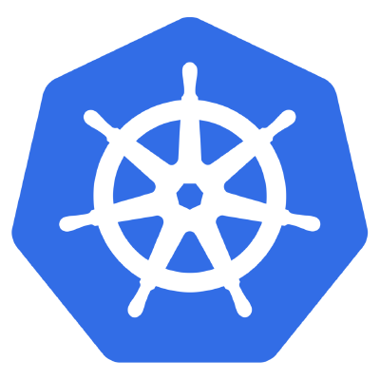
Kubernetes Container Orchestration, Deployment and Scaling

Slide 2
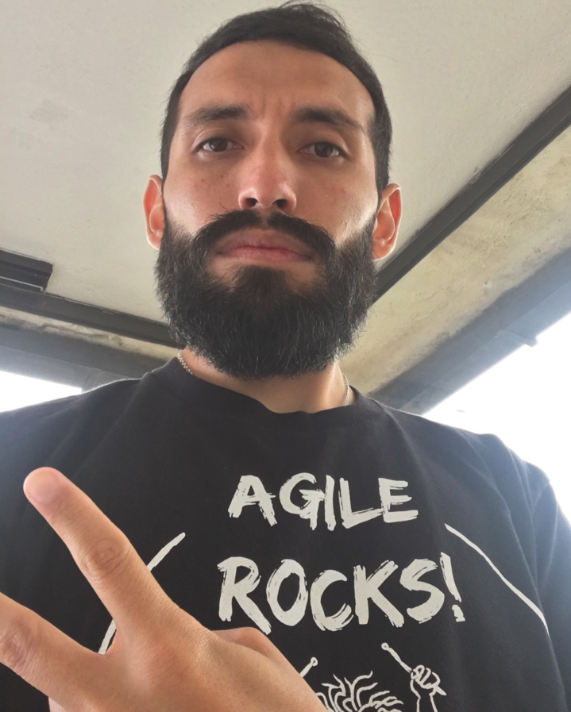



ANGEL NÚÑEZ
Agile and DevOps Specialist,
Consultant & Trainer
angel.nunez@kleer.la
@snahider
Notes:
PAAS
Azure Container Service
Bluemix
Amazon Container Service
Deis

Slide 3

Contenedores y Docker
Notes:
PAAS
Azure Container Service
Bluemix
Amazon Container Service
Deis

Slide 4

Gestionar Múltiples Pequeñas Instancias es Difícil

Slide 5
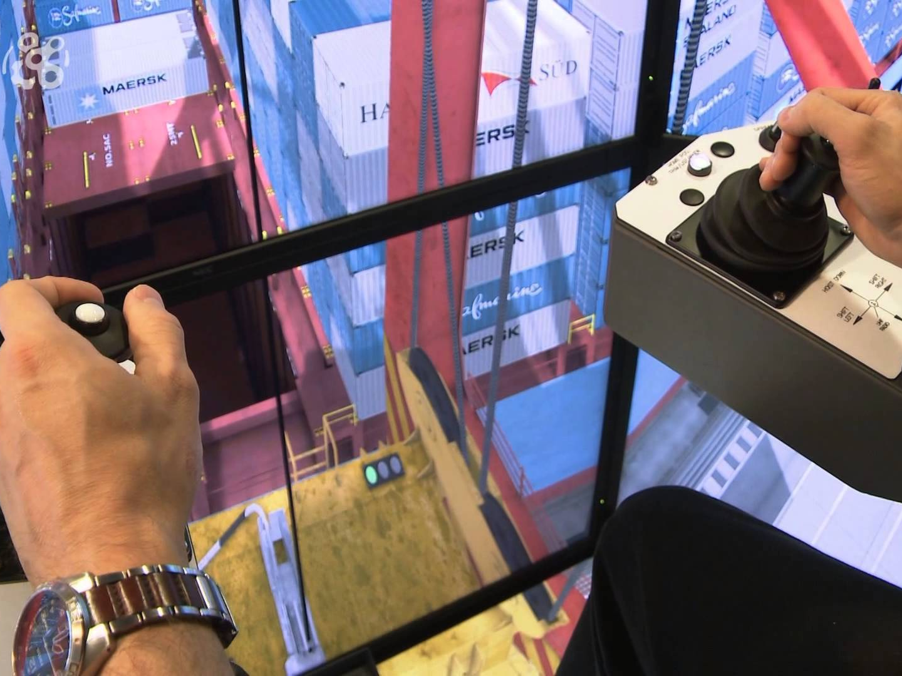
Container Orchestration
Gestionar múltiples contenedores desplegados en múltiples hosts.
Service Discovery
Scheduling
Health Monitoring
Horizontal Scaling
Notes:
http://thenewstack.io/containers-container-orchestration/
While the CLI meets the needs of managing one container on one host, it falls short when it comes to managing multiple containers deployed on multiple hosts. To go beyond the management of individual containers, we must turn to orchestration tools.
Orchestration tools extend lifecycle management capabilities to complex, multi-container workloads deployed on a cluster of machines.
By abstracting the host infrastructure, orchestration tools allow users to treat the entire cluster as a single deployment target.
Scheduling
Deals with negotiating the placement of containers within the cluster and launching them. This process involves selecting an appropriate host based on the configuration.
Discovery
In a distributed deployment consisting of containers running on multiple hosts, container discovery becomes critical. Web servers need to dynamically discover the database servers, and load balancers need to discover and register web servers. Orchestration tools provide, or expect, a distributed key-value store, a lightweight DNS or some other mechanism to enable the discovery of containers.
Rules and Constraints
Workloads often have special policies or requirements for host placement, performance and high availability. For example, it’s pointless to provision the master and slave database container on the same host; it defeats the purpose. Similarly, it may be a good idea to place in-memory cache on the same host as the web server. Orchestration tools support mechanisms for defining the affinity and constraints of container placement.
Health Monitoring
Since orchestration tools are aware of the desired configuration of the system, they are uniquely able to track and monitor the health of the system’s containers and hosts. In the event of host failure, the tools can relocate the container. Similarly, when a container crashes, orchestration tools can launch a replacement. Orchestration tools ensure that the deployment always matches the desired state declared by the developer or operator.

Slide 6
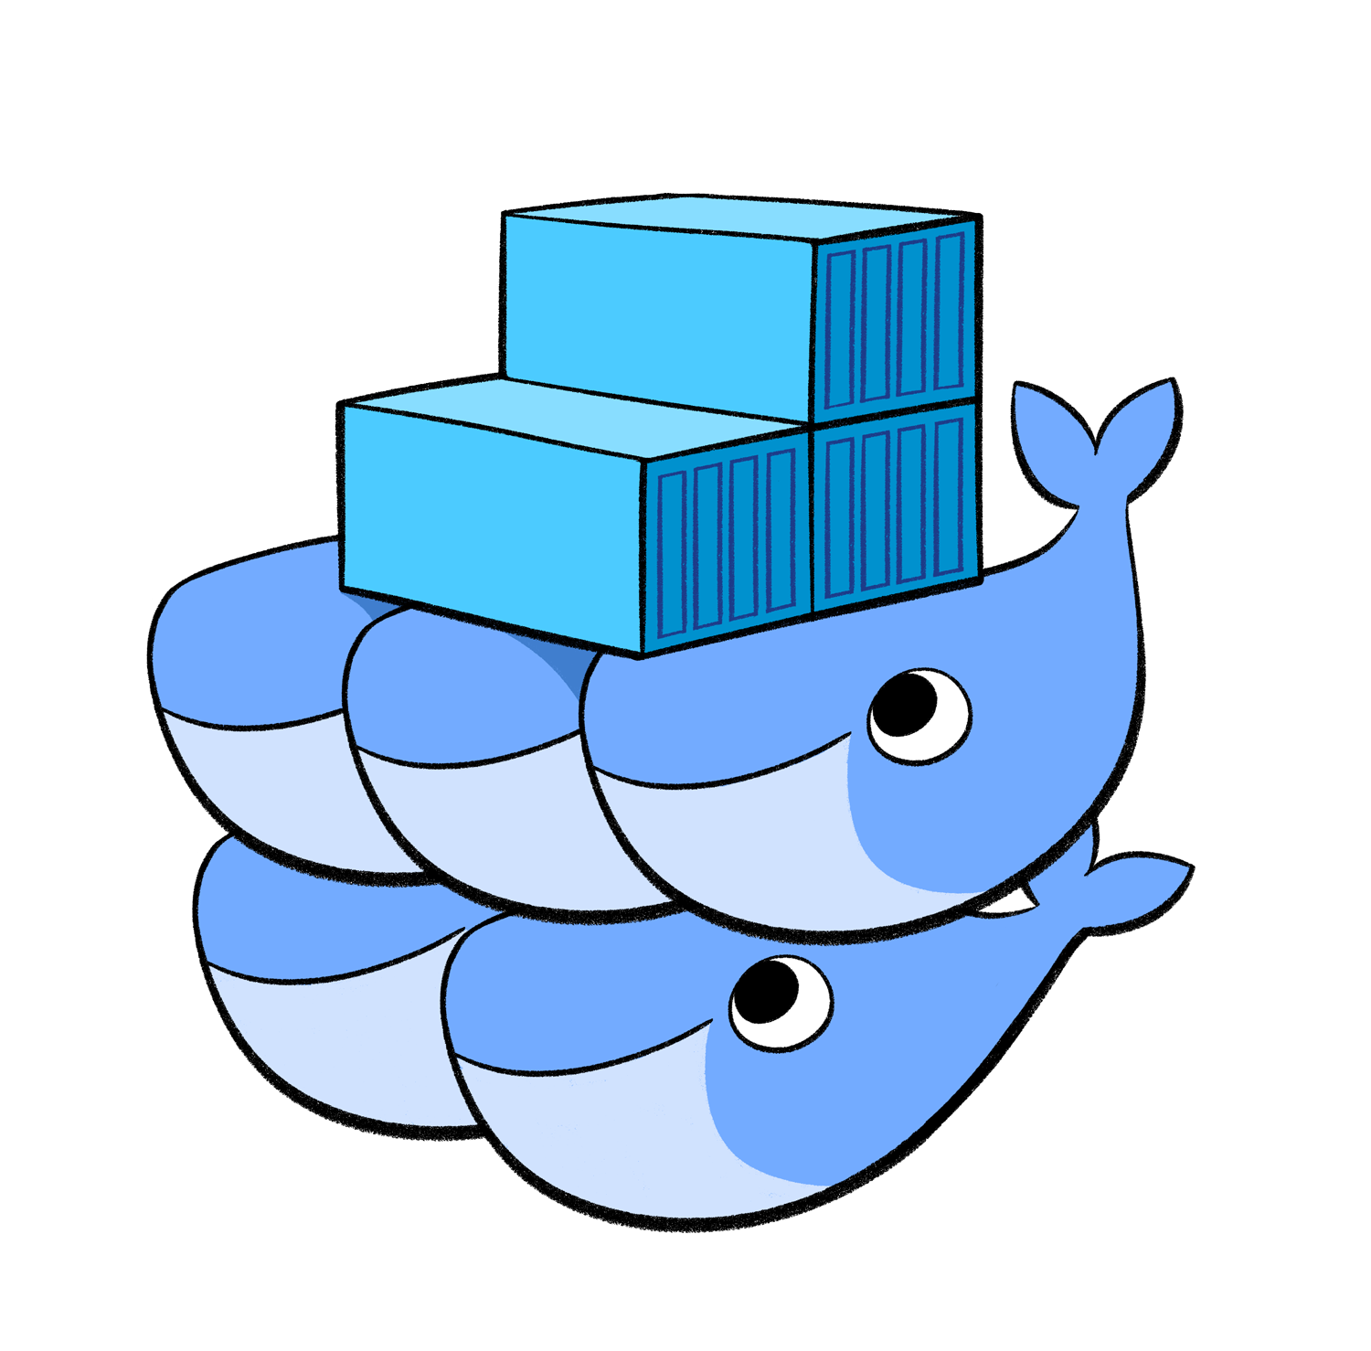

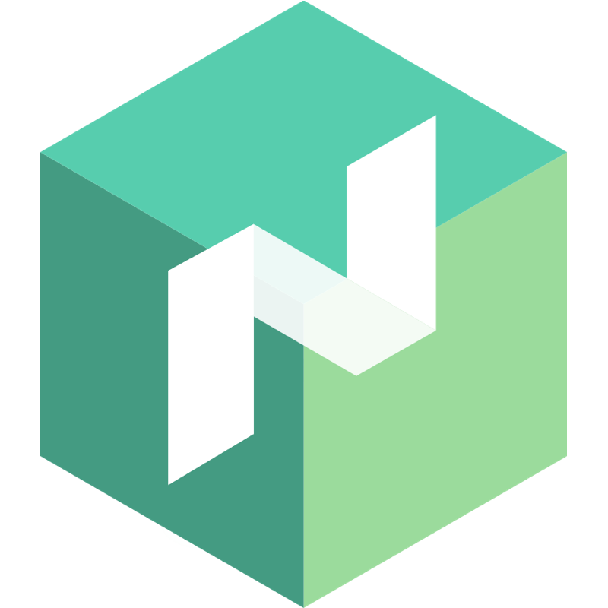
Container Orchestration Tools
Marathon (Mesosphere)
Docker Swarm
Nomad (HashiCorp)
Kubernetes
Notes:
Marathon: A container orchestration platform (Mesos + Marathong)
Mesos: Distribuir elásticamente aplicaciones y sistemas (tolerantes a fallos, alta disponibilidad)
PAAS
Azure Container Service
Bluemix
Amazon Container Service
Deis

Slide 7
Kubernetes
Kubernetes es una plataforma open-source para orquestar, automatizar el despliegue, escalar, gestionar y operar contenedores a través de clusters de hosts.

Slide 8

Planet Scale
Diseñado bajo los mismos principios que permiten a Google ejecutar billones de contenedores a la semana, combinado con las mejores ideas y prácticas de la comunidad.
Notes:
http://kubernetes.io/docs/getting-started-guides/#turn-key-cloud-solutions

Slide 9
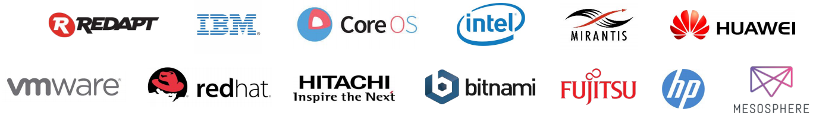

Comunidad
60000+ commits
1600+ contributors
2000+ external projects based on k8s
Compañías contribuyendo
Notes:
Tiene más commits que Docker y muchísimos más que cualquier otra herramienta open source.
Se encuentra entre los proyectos con más contribuciones de todo Github.
Compañias contribuyendo

Slide 10
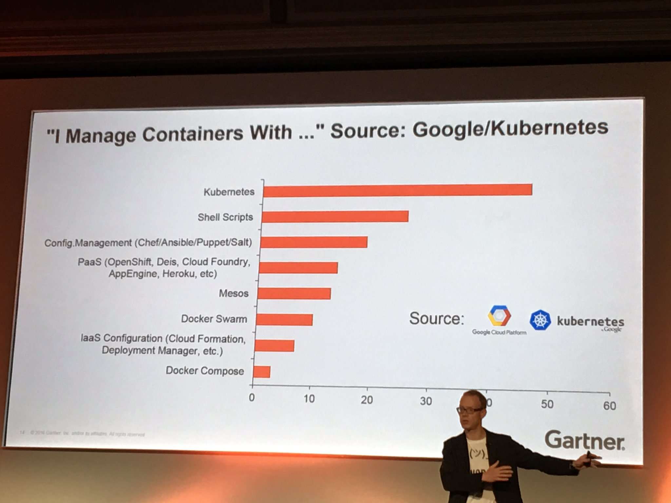
Kubernetes es el orquestador de contenedores más utilizado
Notes:
Tiene más commits que Docker y muchísimos más que cualquier otra herramienta open source.
Compañias contribuyendo

Slide 11
Run Anywhere
Hosted Solutions: Google Container Engine, AWS Elastic Kubernetes, Azure Container Service, RedHat OpenShift, CoreOS Tectonic,
Cloud Providers: GCE, AWS, Azure, DigitalOcean, etc
On-Premise: Centos, Fedora, Ubuntu, CoreOS, Vagrant, etc
Localmente para desarrollar o probar (Minikube) en MacOS ,Linux o Windows, utilizando VirtualBox o VMWare
Notes:
Kubernetes is open source giving you the freedom to take advantage of on-premise, hybrid, or public cloud infrastructure, letting you effortlessly move workloads to where it matters to you.

Slide 12
Kubernetes – Basic Elements
Elementos básicos para trabajar con Kubernetes.
Nodes
Pods
Scheduler
Replica Sets
Deployments
Labels
Services

Slide 13

Nodes
Máquinas donde se ejecutan los contenedores,
Dentro de cada nodo se encuentra Docker Host y diversos agentes de k8s (kubelet, proxy)
K8s considera a la colección de nodos como una sola unidad lógica.

Slide 14
Pods
Mínima unidad lógica desplegable en Kubernetes.
Contienen un grupo de contenedores (usualmente uno).
Se le puede montar volúmenes.
IP diferente por Pod, localhost dentro del Pod.
10.1.0.1
Container
Sidecar Container
Pod
GCE
NFS
AWS
Notes:
Share Namespace,

Slide 15


Replica Sets
Maneja un conjunto replicado de Pods.
Asegura que un número especificado de “Replicas” siempre se estén ejecutando.
Self Healing.
Pod
Pod
Pod

Slide 16
Services
Expone un conjunto de Pods a través de un único nombre/IP y puerto (Service Discovery)
Endpoints estables para acceder a los Pods.
Define una política de acceso (Node Port, Load Balancer, etc.)
Backend (pods) dinámico basado en Labels.
“Name”
Service
10.1.0.1
10.1.0.2
Container
Container
Pod - 1
Pod - 2
Notes:
- Abstrae un conjunto de pods a través un único nombre/ip y puerto.

Slide 17
Scheduler
- Elige el lugar y levanta el Pod dentro de los nodos.
- El mejor lugar es elegido en base a los requerimientos del Pod.
Pod

Slide 18
Kubernetes - Arquitectura
Node
Pod
Pod
Pod
Master
API Server
Scheduler
Docker
kubelet
kube-proxy
Controller Manager
Node
etcd
Pod
Pod
Docker
kubelet
kube-proxy
Notes:
https://kubernetes.io/docs/admin/kube-controller-manager/
kube-apiserver
Configure and validate objects like Pod or Services (definition of access to services in container) through REST API
kube-scheduler
Allocate Pods to each node
kube-controller-manager
Execute Status management, manage replication controller
kubelet
kubelet gets the configuration of a pod from the apiserver and ensures that the described containers are up and running (Manages the pods in the node)
kube-proxy
Acts as a network proxy and a load balancer for a service on a single worker node. It takes care of the network routing for TCP and UDP packets.
etcd
Distribute KVS to store Kubernetes and Calico information

Slide 19
Kubernetes
Naming and Discovery
Replicate instances
Load Balancing
Declarative Infrastructure
Horizontal auto-scaling
Health Checking
Resource Management
Mount Storage Systems
Resource Monitoring
Logging Visualization
Distributing Secrets
Rolling Updates
Blue/Green Deployments
Federation

Slide 20
Cómo comenzar con Kubernetes
Utilizar una alternativa ya hosteada (Google Cloud, Redhat OpenShift, Azure Container Service, etc.)
MiniKube: en 2 clics instalas Kubernetes localmente en una máquina virtual. https://github.com/kubernetes/minikube
Kubernetes Interactive Tutorial https://kubernetes.io/docs/tutorials/kubernetes-basics/

Slide 21
ANGEL NÚÑEZ
Agile and DevOps Specialist,
Consultant & Trainer
angel.nunez@kleer.la
@snahider

Slide 22
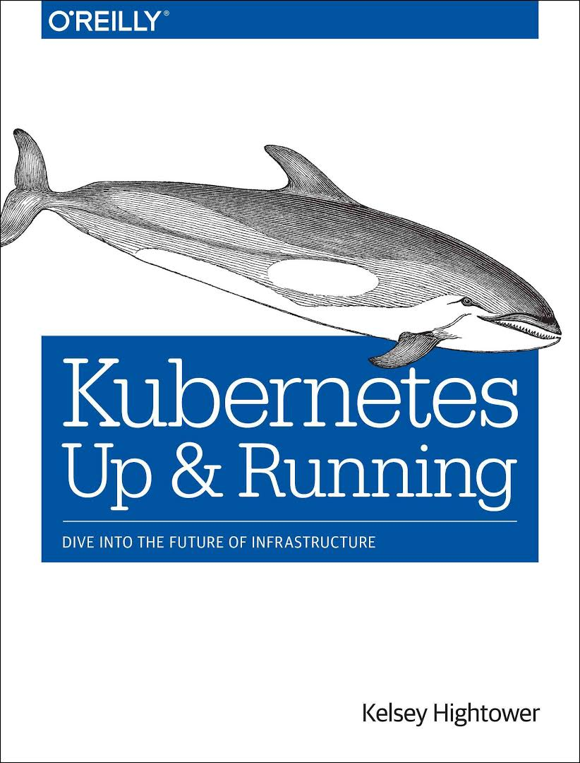
Referencias
Presentación (slides y código):
https://github.com/snahider/kubernetes-talk.git

